Slide 1
Remote Controlled R2-D2 Sith Happens
Daniel Suen
Steven Paek

Slide 2
Project Summary
Remote Controlled “R2-D2” using RC Car Frame and Controller
R2-D2: Movement controlled by joystick, plays audio based on controller inputs, fires nerf bullets, and uses RGB LEDs to display temperatures
Controller: Uses joystick to control movement, buttons for sound selection and other functions, (goal) text-to-speech keyboard, and all communication via XBee

Slide 3
Project Objectives
Digital Objectives:
XBee UART Communication
PWM Control for Motors
Microprocessor Controls for R2-D2 and Controller (GPIO)
Nerf Bullet Control
Analog Objectives:
Battery Recharge Circuit
Joystick Control
Thermistor-LED Control
Audio Output from Speaker

Slide 4
Technology Selection
MSP432P401R: Up to 48MHz CPU, FPU, 14-bit ADC, UART, 16-bit Timers with PWM (Robot/Controller)
Xbee: RF Module IEEE 802.15.4 Standard, UART Communication (Robot/Controller)
L293D: PWM Motor Driver (Robot)
LTC1661: 10-bit External DAC, 2.7V to 5.5V Supply (Robot)
LM386: Low Voltage Audio Power Amplifier (Robot)
Joystick: Analog Joystick

Slide 5
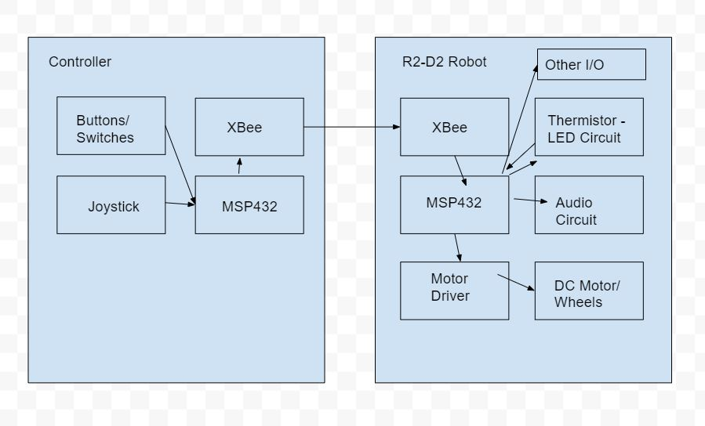
Flowchart/Diagrams

Slide 6
Work Responsibilities
Printed Circuit Boards (PCBs)
R2-D2 PCB (Steven)
Controller PCB (Daniel)
Battery Recharge PCB (Daniel)
R2-D2 (Robot)
Motor PWM (Steven)
Audio Circuit with External DAC (Steven)
Thermistor-LED (Steven)
Other I/O - Nerf Gun, etc. (Steven)
Controller
Joystick Control (Daniel)
Controller I/O for Sound, Nerf Gun, and Movement (Daniel)
XBee Communication (Daniel)

Slide 7
Gantt Chart

